Slide 1

EPILEPTIC SEIZURE DETECTION Final Review
Presented by:
Afreen A – 126004008
Clementena J – 126004059
Dharshini H – 126004071
Guided by:
Dr NARASHIMAN K
SEEE

Slide 2
Outline
Introduction
Problem Statement
Literature Survey
Work Plan
5. Work carried out
6. References

Slide 3

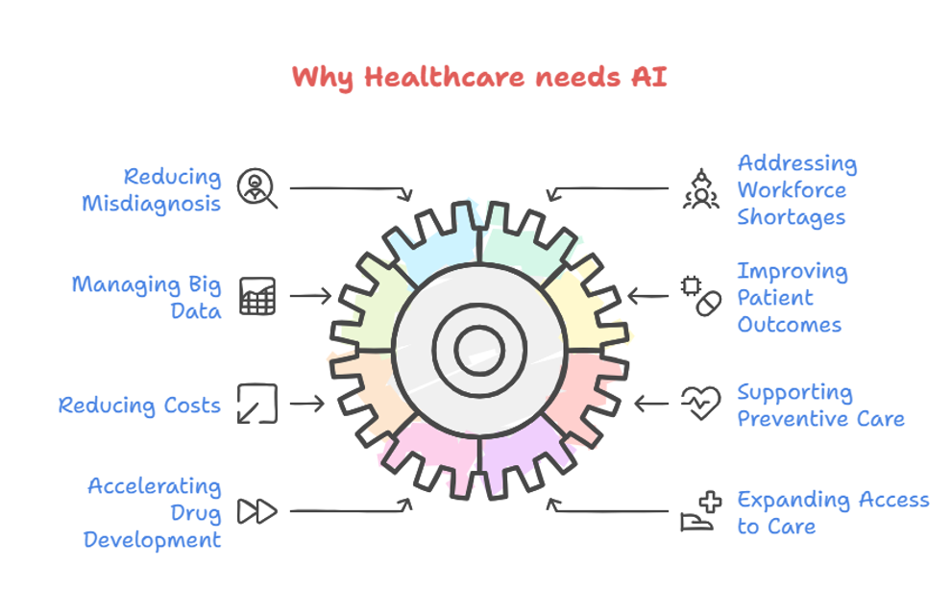

Slide 4
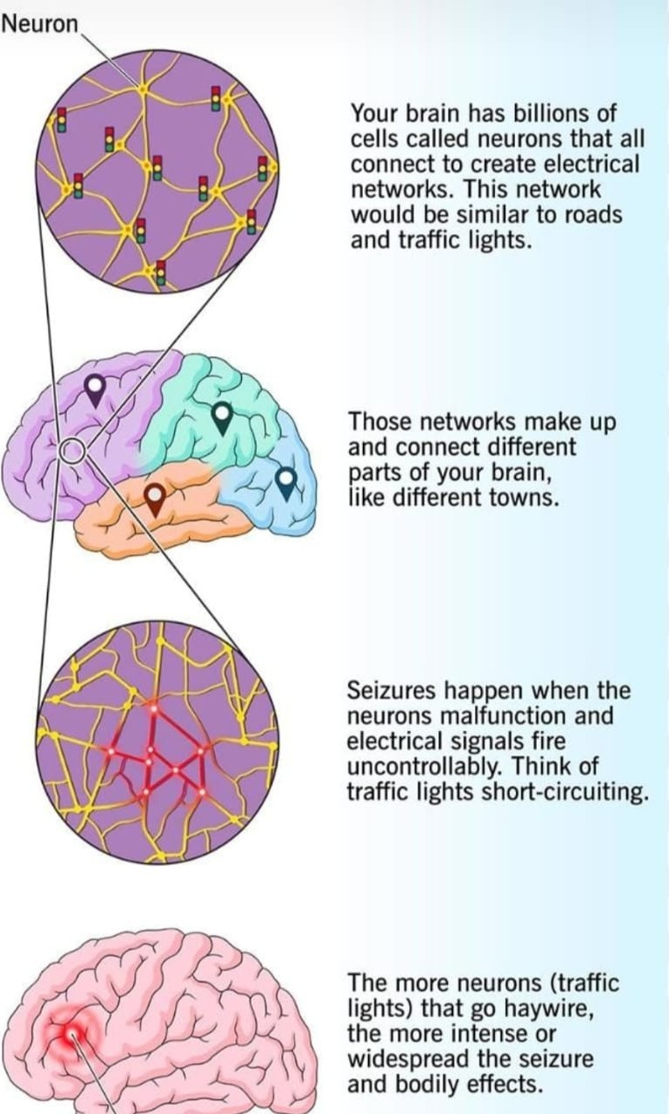
Introduction:
Epilepsy is a group of neurological disorders.
It affects 50 million patients worldwide
EEG is used for diagnosis, but visual analysis can be ambiguous
Quantitative analysis,machine learning and deep learning can improve classification

Slide 5
Problem Statement :
Epilepsy is a neurological disorder characterized by recurrent seizures. Traditional seizure detection through EEG analysis is time-consuming and requires expert intervention. Our project aims to develop an automated machine learning & deep learning based seizure detection system to enhance accuracy, reduce diagnosis time and enable early intervention.

Slide 6
Objective :
To preprocess EEG signals for noise reduction and feature extraction.To implement and compare different classification algorithms for EEG signal analysis.
To develop a model that enhances the accuracy of EEG signal classification for auditory stimulus recognition.
To explore potential applications of EEG-based sound analysis in medical and assistive technologies.

Slide 7
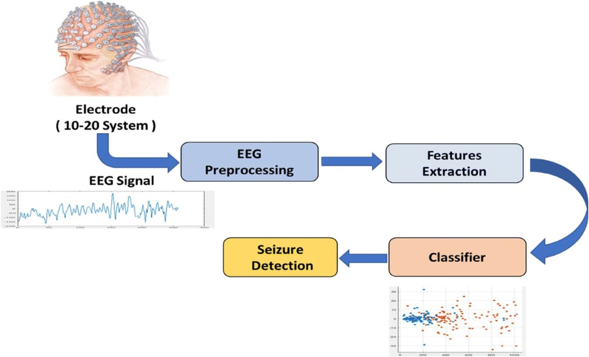
Methodology:

Slide 8
Literature Survey:
S.No | Name of the paper | Methods Used | Inference
1. | A Deep Learning Framework for Neonatal Seizure Detection Using EEG Signals. | Convolutional Neural Networks (CNNs) for EEG signal classification.Sliding Window Technique for segmenting signals and balancing seizure/non-seizure data.Preprocessing Techniques to Enhance Signal Quality.Data Balancing to address class imbalance.Custom CNN Architecture Design optimized for neonatal EEG signals | It shows that careful data preprocessing, effective class balancing using sliding windows, and a well-designed CNN architecture can significantly improve the accuracy of neonatal seizure detection, achieving classification performance as high as 96%–97%.
2. | A Review of Epileptic Seizure Detection Using Machine Learning Classifiers (2020) | Machine Learning (ML) Classifiers: Decision Trees, Support Vector Machines (SVM), k-Nearest Neighbors (KNN), and Random Forest.Statistical Features-Based Classification: Uses handcrafted features like wavelet transform, power spectral density, and entropy. Black-Box vs. Non-Black-Box Approaches:Black-box models (e.g., Neural Networks) provide high accuracy but lack explainability.Non-black-box models (e.g., Decision Trees, SVM) offer interpretability but may have lower accuracy. | ML-based approaches require manual feature extraction, which can affect accuracy.Selecting the right classifier and feature set is crucial for performance. EEG signals are high-dimensional, non-stationary, and noisy, making feature selection difficult.

Slide 9
Literature Survey
S.No | Name of the paper | Methods Used | Inference
3. | EEG sound analysis using classical machine learning algorithms and convolutional neural networks | Their research pointed out the capacity of CNNs to extract spatial and temporal features from EEG signals, leading to improved classification performance. They also showed that the combination of traditional methods with CNNs can achieve significant improvements in seizure detection accuracy. | By integrating classical machine learning techniques with CNN-based approaches, the researchers achieved enhanced classification performance, indicating that hybrid models can offer a promising path for improving the reliability and accuracy of EEG-based seizure detection systems.

Slide 10
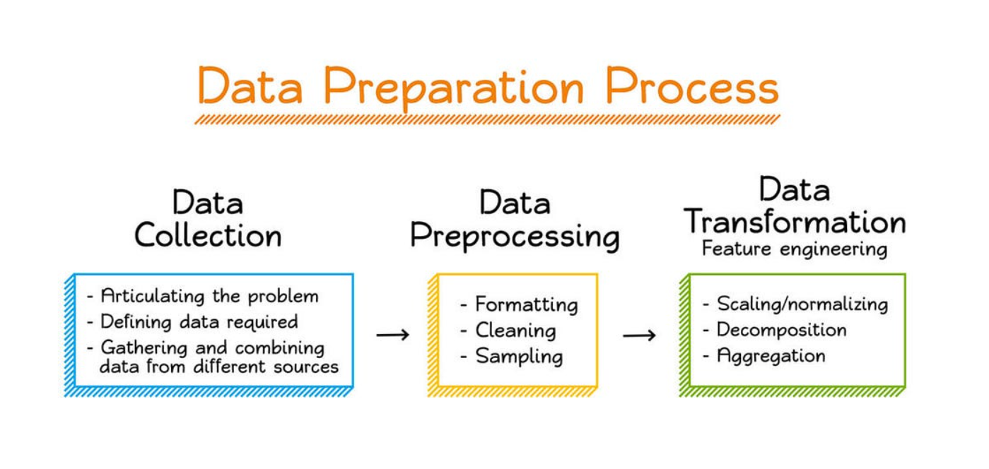
Workflow:

Slide 11
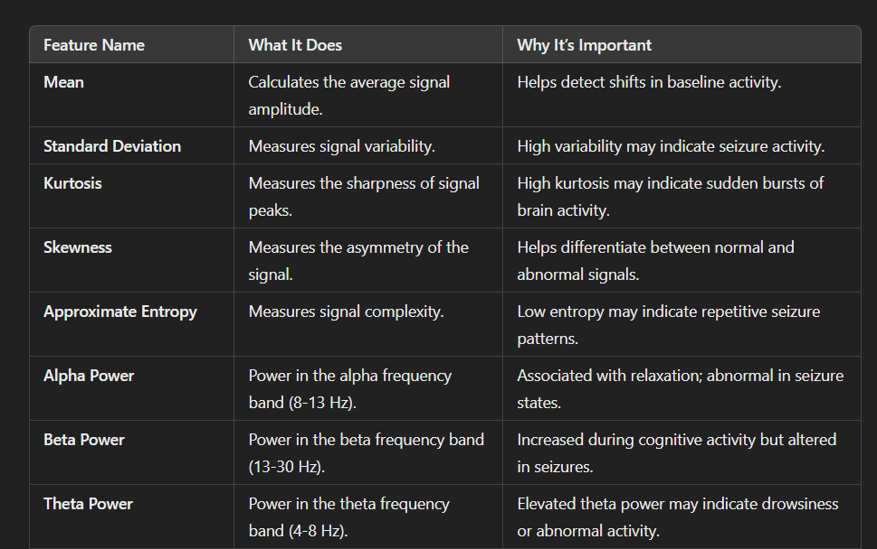
Feature Extraction:

Slide 12
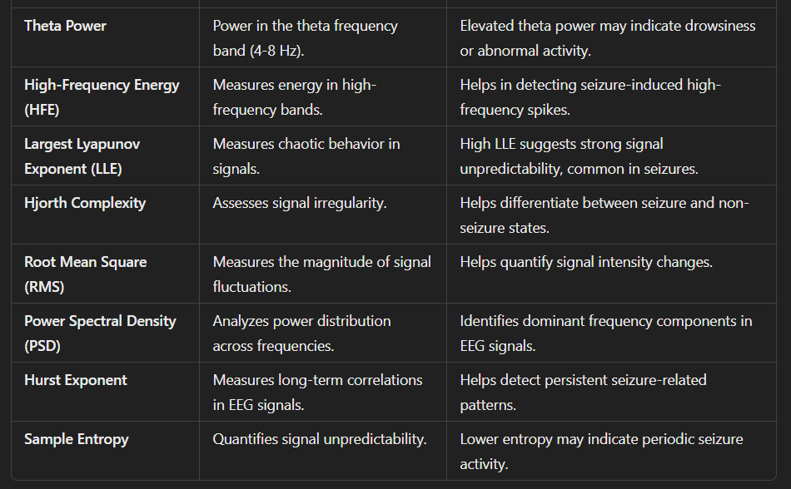

Slide 13
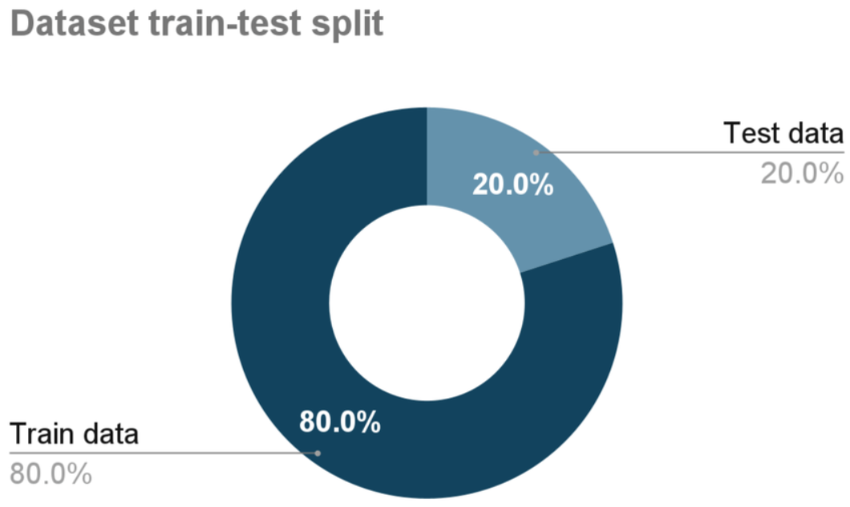
Training and Spliting:

Slide 14
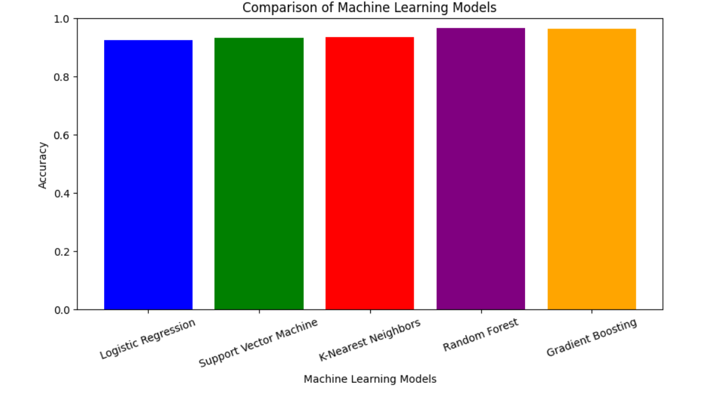
Model Selection:

Slide 15
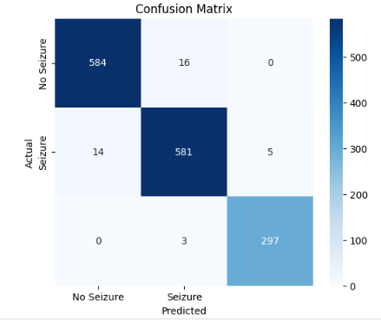
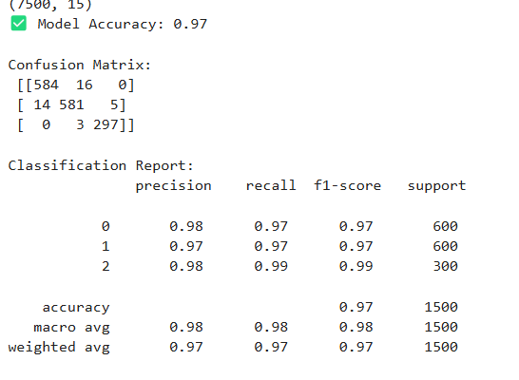
Accuracy & Confusion Matrix:

Slide 16
TESTED RESULTS OF ML:
Predicted Labels (y_pred):
[1 0 1 0 0 0 1 0 2 0 2 0 2 0 1 2 0 1 1 1 0 1 2 1 0 1 1 1 1 0 1 0 1 0 0 1 2 1 1 2 1 0 0 0 0 1 0 2 2 1 0 1 0 0 1 1 1 0 0 0 2 0 1 1 1 0 1 2 0 1 1 1 0 2 1 2 1 0 2 2 0 0 1 0 0 1 2 1 0 1 2 0 2 2 1 0 1 0 2 1 0 2 1 2 0 0 1 1 0 0 1 1 0 0 0 1 0 0 1 0 0 2 0 1 0 1 1 1 1 1 2 0 2 0 1 0 0 2 1 1 0 1 0 2 1 2 0 0 0 0 2 1 1 1 1 0 0 2 1 1 0 0 0 2 0 0 1 2 0 0 1 1 1 2 1 1 2 1 0 2 0 1 0 0 2 1 0 0 0 1 1 1 0 0 0 1 0 0 2 0 1 0 2 2 0 0 1 0 2 0 0 0 2 0 1 1 2 0 1 1 1 0]
Actual Labels (y_val):
[1 0 1 0 0 0 1 0 2 0 2 0 2 0 1 2 0 1 1 1 0 1 2 1 0 1 1 1 1 0 1 0 1 0 0 1 2 1 1 2 1 0 0 0 0 1 0 1 2 1 0 1 0 0 1 1 1 0 0 0 2 0 1 1 1 0 1 2 0 1 1 1 0 2 1 2 1 0 2 2 0 0 1 0 0 1 2 1 0 1 2 0 2 2 1 0 1 0 2 1 0 2 1 2 0 0 1 1 0 0 1 1 0 0 0 1 0 0 1 0 0 2 0 1 0 1 1 1 1 1 2 0 2 0 0 1 0 2 1 1 0 1 0 2 1 2 0 0 0 0 2 0 1 1 1 0 0 2 1 1 0 0 0 2 0 0 1 2 0 0 1 1 1 2 1 1 2 1 0 2 0 1 0 0 2 1 0 0 0 1 1 1 0 0 0 1 0 0 2 0 1 0 2 1 0 0 1 0 2 0 0 0 2 0 1 1 2 0 1 1 1 0]

Slide 17
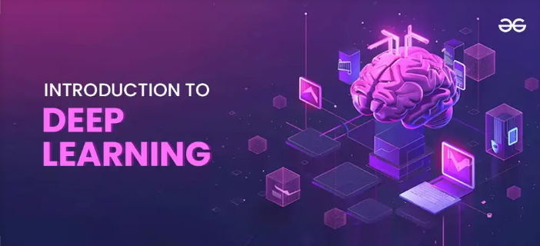

INTRODUCTION TO DEEP LEARNING:
Deep learning is a subset of machine learning that uses neural networks with many layers (hence "deep") to automatically learn patterns and features from data. Unlike traditional ML, it doesn't require manual feature extraction
it learns directly from raw or minimally processed data.
Why We Used Deep Learning in This Project:
EEG signals are complex, non-linear, and high-dimensional.
Deep learning models can automatically extract features, capture temporal patterns (like seizures), and learn spatial characteristics from raw EEG.
We needed models that can generalize well to unseen brain activity patterns for accurate seizure detection.
Traditional ML gave high accuracy (Random Forest – 97%), but deep learning provided:
Higher potential accuracy
Better adaptability to new data
Less reliance on manual feature engineering

Slide 18
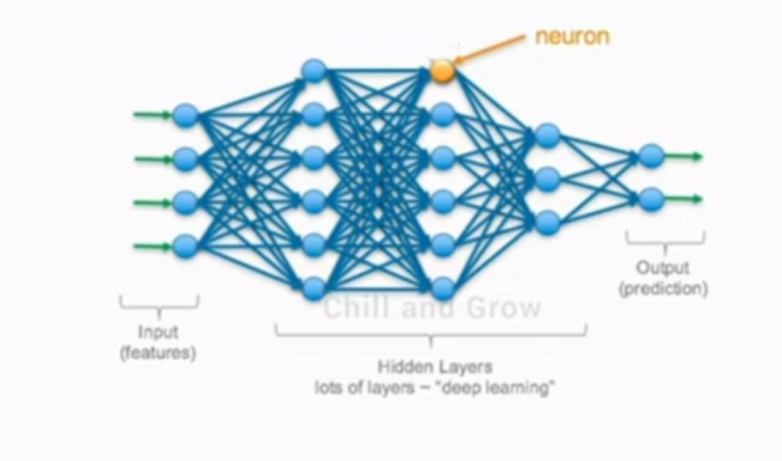
Block Diagram of DL:

Slide 19
General Steps for All Deep Learning Models:
Data Collection & Preprocessing
EEG signal data from three classes:
Normal , Epilepsy Without Seizure, epilepsy with seizure.
Data converted into Excel format from .txt files
Normalized, segmented into fixed-length windows
Train-validation split
Label Encoding
Classes encoded as 0, 1, 2
One-hot encoding where needed
Model Building
Architecture defined using PyTorch (or Keras/TensorFlow if used separately)
Specific layers used depending on model (see per-model below)
Training
Optimizer: Adam
Loss Function: Cross EntropyLoss
Batch size, epochs, early stopping applied
Weighted loss sometimes used to handle class imbalance
Evaluation
Confusion Matrix , Classification Report (Precision, Recall, F1-score)
Accuracy Metric

Slide 20
INDIVIDUAL MODEL STEPS:
1D CNN:
Used Conv1D layers to extract temporal features from raw EEG sequences
Pooling layers used to reduce dimensionality
Flattened + Dense layers for classification
Achieved: 99% accuracy (3 misclassifications)
LSTM Only:
LSTM layer to capture temporal dependencies in EEG sequences
Followed by Dense layers
Training resulted in overfitting; confusion matrix misaligned
Accuracy: 73%
GRU Only:
GRU layer used instead of LSTM (simpler and faster)
Also struggled with alignment; confusion matrix wrong
Accuracy: 72%

Slide 21
1D CNN + LSTM:
CNN layers extract spatial features
Output fed into LSTM to capture sequential relations
Better generalization than pure LSTM
Accuracy: 95%
1D CNN + GRU:
Similar to CNN+LSTM but uses GRU for sequence modeling
Slightly lower accuracy than LSTM variant
Accuracy: 93%
Custom 2D CNN:
EEG data reshaped into 2D format
Conv2D layers used to extract spatial patterns
Pooling, Flatten, Dense layers
Accuracy: 99% (2 misclassifications)
ResNet18 (Transfer Learning):
Pretrained ResNet18 model used (originally for images)
EEG 2D images fed as input
Final FC layer modified for 3-class classification
Very high performance
Accuracy: 98% with only 2 misclassifications

Slide 22
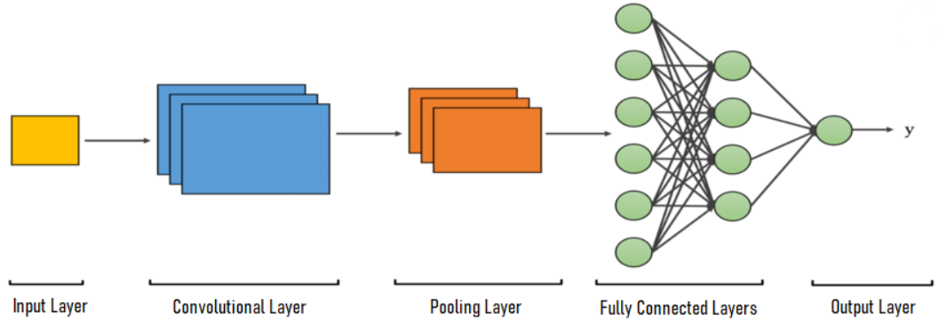
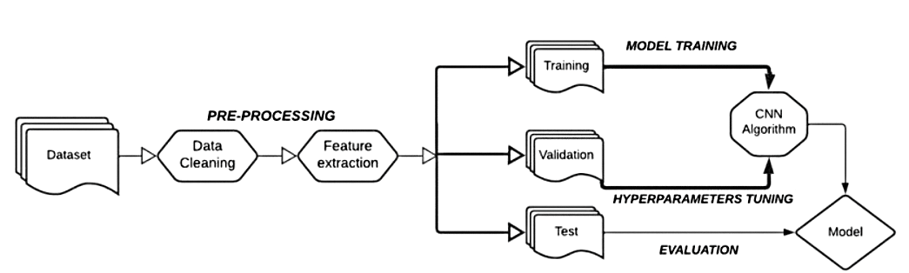
1D-CNN:
Architecture
Block Diagram

Slide 23
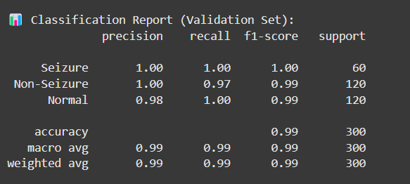
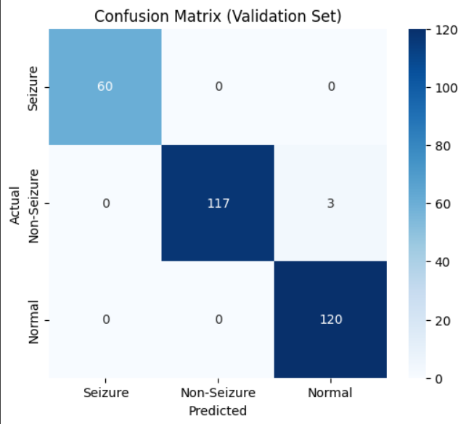
1D CNN:

Slide 24
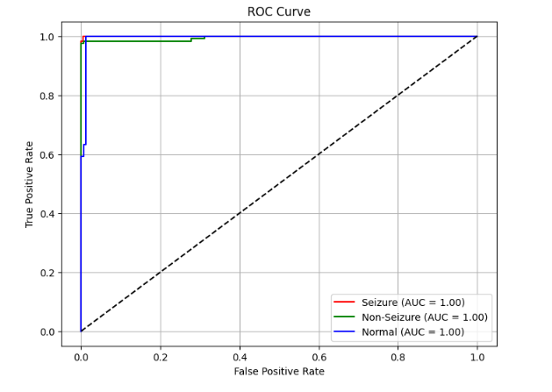
TESTED RESULTS FOR 1D CNN:
🎯 Actual y_val labels:
[1 2 2 2 0 2 1 2 2 1 1 2 1 2 0 1 2 2 1 1 2 1 2 1 0 0 0 1 1 2 2 1 2 2 2 0 0 2 2 2 1 1 2 0 2 1 1 0 2 1 0 1 1 1 2 2 1 2 2 0 1 2 2 1 2 1 1 2 1 0 2 0 1 0 2 1 2 1 2 2 2 1 0 1 1 1 2 2 1 2 1 2 1 0 1 2 2 2 2 1 1 1 2 2 0 2 2 1 2 2 1 2 1 1 1 1 1 2 0 1 1 2 2 1 2 2 1 1 0 1 1 1 2 2 1 0 1 2 2 0 1 1 2 2 1 2 2 0 0 1 0 0 2 1 1 2 2 1 0 0 2 2 1 1 0 0 2 1 1 1 1 2 0 0 1 1 0 1 0 1 2 1 2 0 1 2 1 0 0 0 1 2 1 1 2 0 0 2 1 1 2 2 1 2 0 1 0 1 0 2 2 1 2 1 2 0 2 1 1 2 1 2 0 2 0 2 2 2 1 0 2 0 2 2 1 1 0 0 2 2 1 2 0 1 2 1 2 2 2 1 1 1 0 1 2 1 2 0 2 1 1 2 2 0 1 0 2 2 2 2 1 1 0 0 2 1 1 2 2 2 1 1 2 1 1 1 0 0 2 1 2 1 1 1 1 0 2 2 1 0]
🔮 Predicted y_val labels:
[1 2 2 2 0 2 1 2 2 1 1 2 1 2 0 1 2 2 1 1 2 1 2 1 0 0 0 1 1 2 2 1 2 2 2 0 0 2 2 2 1 1 2 0 2 1 1 0 2 1 0 1 1 1 2 2 1 2 2 0 1 2 2 1 2 1 1 2 1 0 2 0 1 0 2 2 2 1 2 2 2 1 0 1 1 1 2 1 1 2 1 2 1 0 1 2 2 2 2 1 1 1 2 2 0 1 2 1 2 2 1 2 1 2 1 1 1 2 0 1 1 2 2 1 2 2 1 1 0 1 1 1 2 2 1 0 1 2 2 0 1 1 2 2 1 2 2 0 1 1 0 0 2 1 1 2 2 1 0 0 2 2 1 1 0 0 2 1 1 1 1 2 0 0 1 1 0 1 0 1 2 1 2 0 1 2 1 0 0 0 1 2 1 1 2 0 0 2 1 1 2 2 1 2 0 1 0 1 0 2 2 1 2 1 2 0 2 1 1 1 1 2 0 2 0 2 2 2 1 0 2 0 2 2 1 1 0 0 2 2 1 2 0 1 2 1 2 2 2 1 1 1 0 1 2 1 2 0 2 1 1 2 2 0 1 0 2 2 2 1 1 1 0 0 2 1 1 2 2 2 0 1 2 1 1 1 0 0 2 1 2 1 1 1 2 0 2 2 1 0]

Slide 25
LSTM:
Block diagram

Slide 26
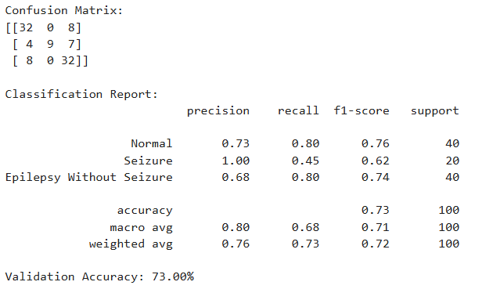
Architecture Confusion Matrix and Classification Report

Slide 27
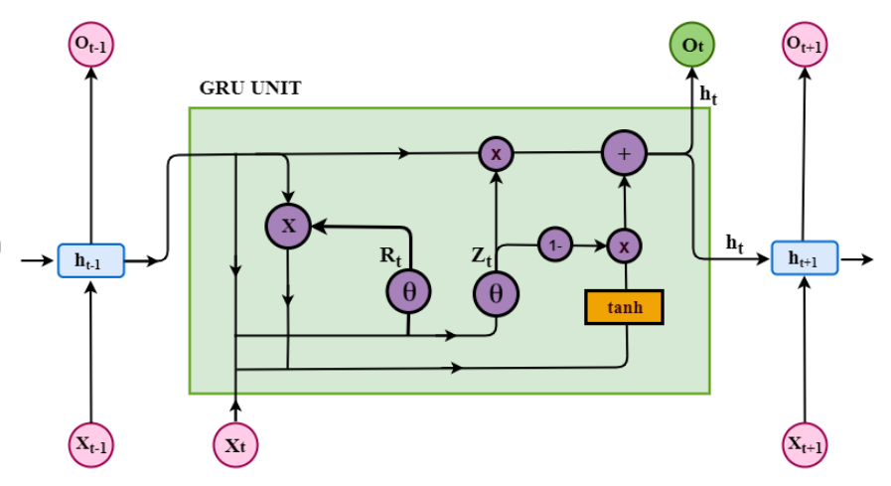
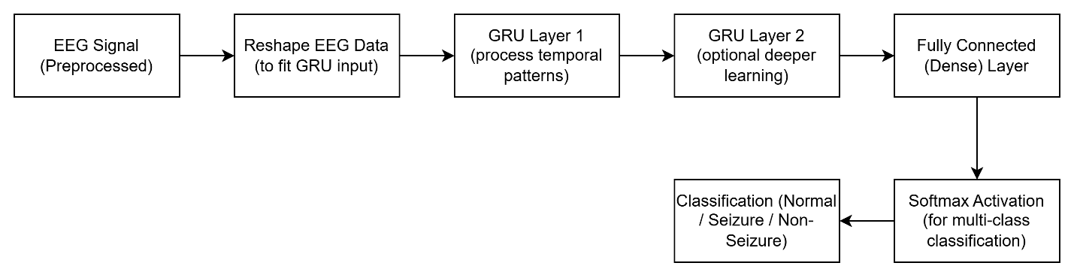
GRU:
Architecture
Block diagram

Slide 28
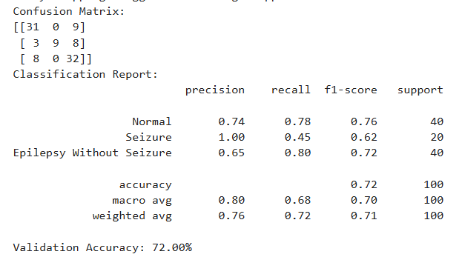
Classification report & confusion matrix:

Slide 29
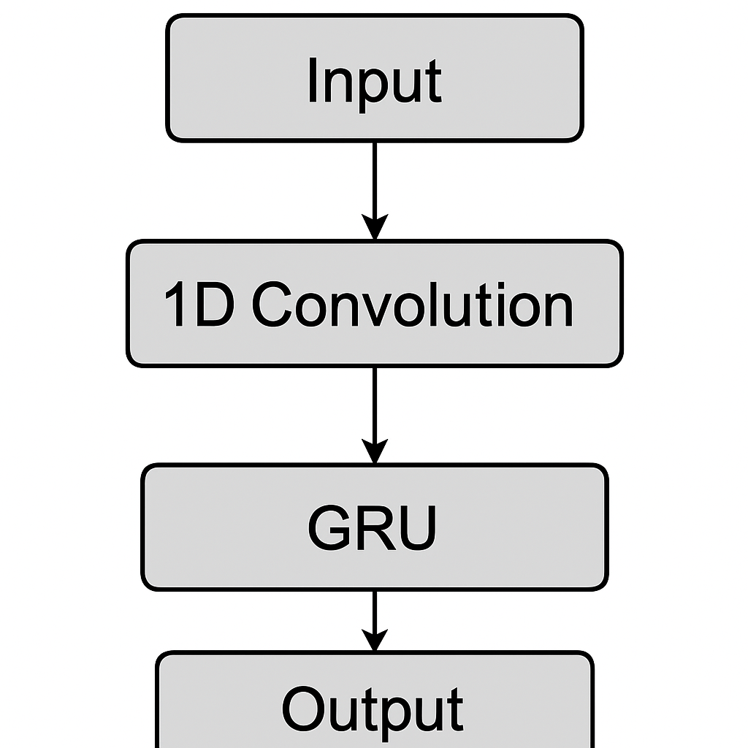
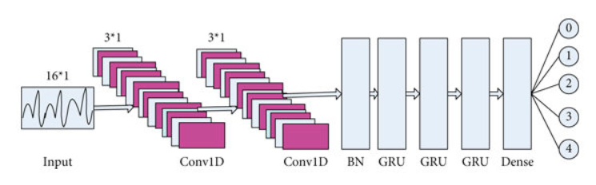
1DCNN+GRU:
Architecture
Block diagram

Slide 30
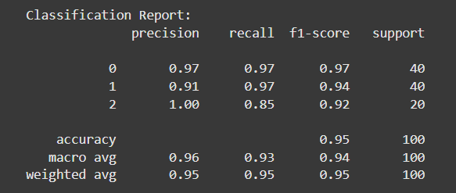
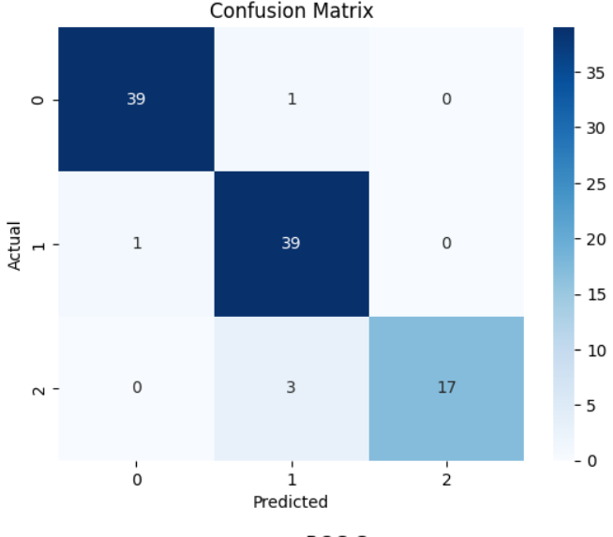
Classification report & Confusion matrix:

Slide 31
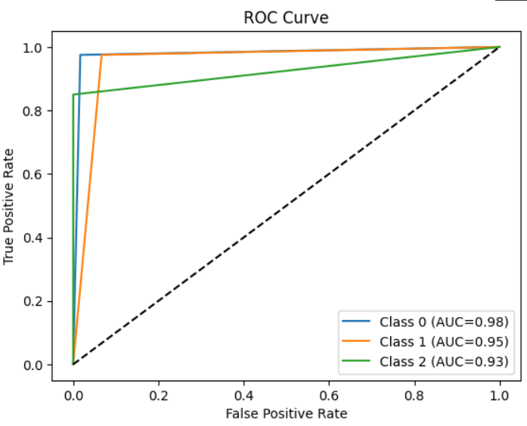
TESTED RESULTS FOR 1D CNN+GRU
Predicted labels (y_val_pred):
[0 0 0 0 0 0 0 0 0 0 0 0 0 0 0 0 0 0 0 0 0 0 0 0 0 0 0 1 0 0 0 0 0 0 0 0 0 0 0 0 1 1 1 1 1 1 1 1 1 1 1 1 1 1 1 1 1 1 1 1 1 1 1 1 1 1 1 1 1 1 1 1 1 1 1 1 1 1 1 1 2 2 2 2 2 2 2 2 2 2 2 2 2 2 2 1 2 2 2 2]
True labels (y_val):
[0 0 0 0 0 0 0 0 0 0 0 0 0 0 0 0 0 0 0 0 0 0 0 0 0 0 0 0 0 0 0 0 0 0 0 0 0 0 0 0 1 1 1 1 1 1 1 1 1 1 1 1 1 1 1 1 1 1 1 1 1 1 1 1 1 1 1 1 1 1 1 1 1 1 1 1 1 1 1 1 2 2 2 2 2 2 2 2 2 2 2 2 2 2 2 2 2 2 2 2]

Slide 32
1DCNN+LSTM:
Architecture Block diagram

Slide 33
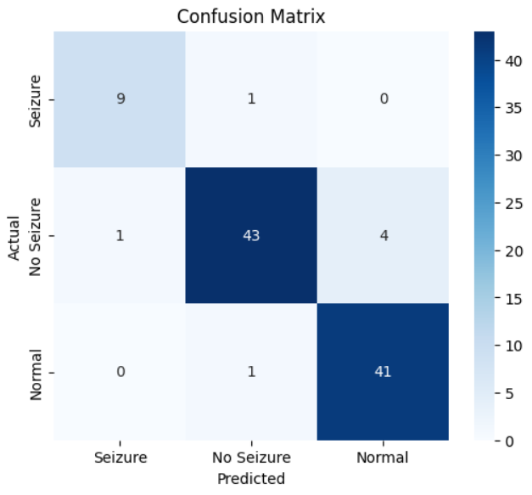
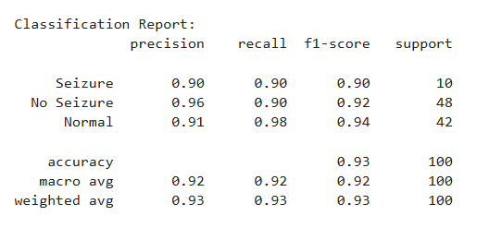
1DCNN+LSTM:

Slide 34
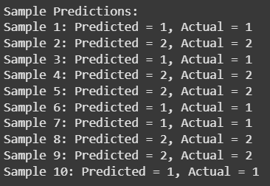
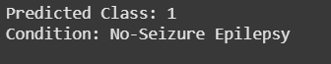
TESTED RESULTS FOR 1DCNN+LSTM:

Slide 35
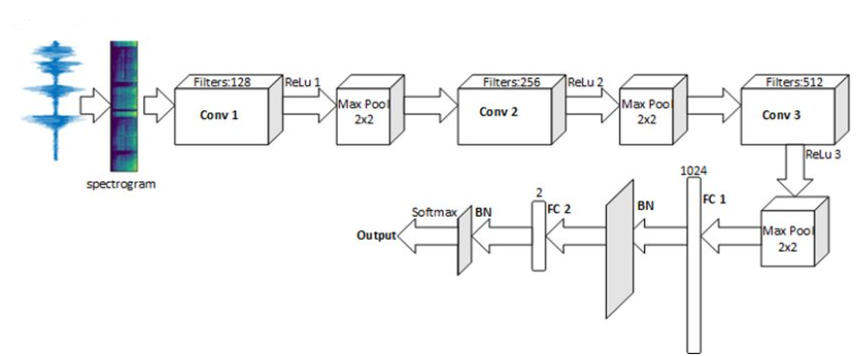
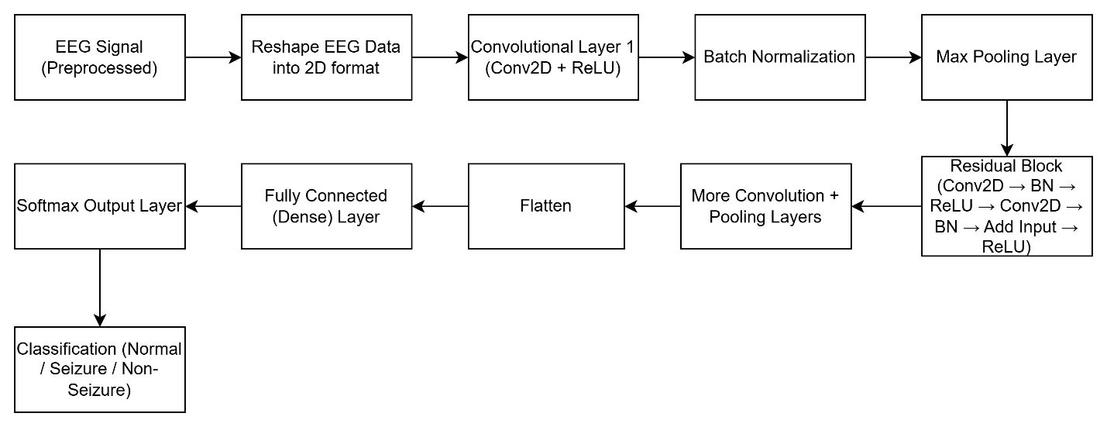
Custom 2D-CNN:
Architecture
Block Diagram

Slide 36
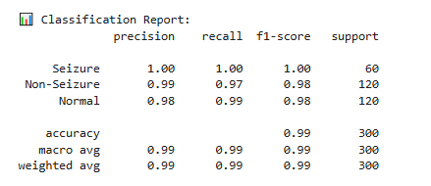
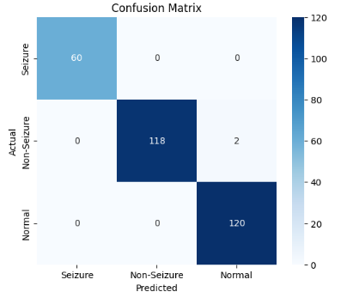
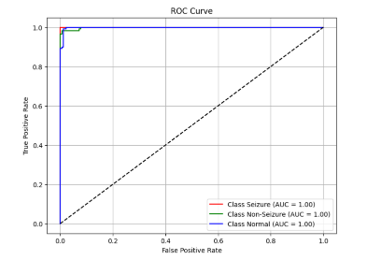
CUSTOM 2D CNN:

Slide 37
TESTED RESULTS FOR 2D CNN:
🎯 Actual y_val labels:
[1 2 2 2 0 2 1 2 2 1 1 2 1 2 0 1 2 2 1 1 2 1 2 1 0 0 0 1 1 2 2 1 2 2 2 0 0 2 2 2 1 1 2 0 2 1 1 0 2 1 0 1 1 1 2 2 1 2 2 0 1 2 2 1 2 1 1 2 1 0 2 0 1 0 2 1 2 1 2 2 2 1 0 1 1 1 2 2 1 2 1 2 1 0 1 2 2 2 2 1 1 1 2 2 0 2 2 1 2 2 1 2 1 1 1 1 1 2 0 1 1 2 2 1 2 2 1 1 0 1 1 1 2 2 1 0 1 2 2 0 1 1 2 2 1 2 2 0 0 1 0 0 2 1 1 2 2 1 0 0 2 2 1 1 0 0 2 1 1 1 1 2 0 0 1 1 0 1 0 1 2 1 2 0 1 2 1 0 0 0 1 2 1 1 2 0 0 2 1 1 2 2 1 2 0 1 0 1 0 2 2 1 2 1 2 0 2 1 1 2 1 2 0 2 0 2 2 2 1 0 2 0 2 2 1 1 0 0 2 2 1 2 0 1 2 1 2 2 2 1 1 1 0 1 2 1 2 0 2 1 1 2 2 0 1 0 2 2 2 2 1 1 0 0 2 1 1 2 2 2 1 1 2 1 1 1 0 0 2 1 2 1 1 1 1 0 2 2 1 0]
🔮 Predicted y_val labels:
[1 2 2 2 0 2 1 2 2 1 1 2 1 2 0 1 2 2 1 1 2 1 2 1 0 0 0 1 1 2 2 1 2 2 2 0 0 2 2 2 1 1 2 0 2 1 1 0 2 1 0 1 1 1 2 2 1 2 2 0 1 2 2 1 2 1 1 2 1 0 2 0 1 0 2 2 2 1 2 2 2 1 0 1 1 1 2 1 1 2 1 2 1 0 1 2 2 2 2 1 1 1 2 2 0 1 2 1 2 2 1 2 1 2 1 1 1 2 0 1 1 2 2 1 2 2 1 1 0 1 1 1 2 2 1 0 1 2 2 0 1 1 2 2 1 2 2 0 1 1 0 0 2 1 1 2 2 1 0 0 2 2 1 1 0 0 2 1 1 1 1 2 0 0 1 1 0 1 0 1 2 1 2 0 1 2 1 0 0 0 1 2 1 1 2 0 0 2 1 1 2 2 1 2 0 1 0 1 0 2 2 1 2 1 2 0 2 1 1 1 1 2 0 2 0 2 2 2 1 0 2 0 2 2 1 1 0 0 2 2 1 2 0 1 2 1 2 2 2 1 1 1 0 1 2 1 2 0 2 1 1 2 2 0 1 0 2 2 2 1 1 1 0 0 2 1 1 2 2 2 0 1 2 1 1 1 0 0 2 1 2 1 1 1 2 0 2 2 1 0]

Slide 38
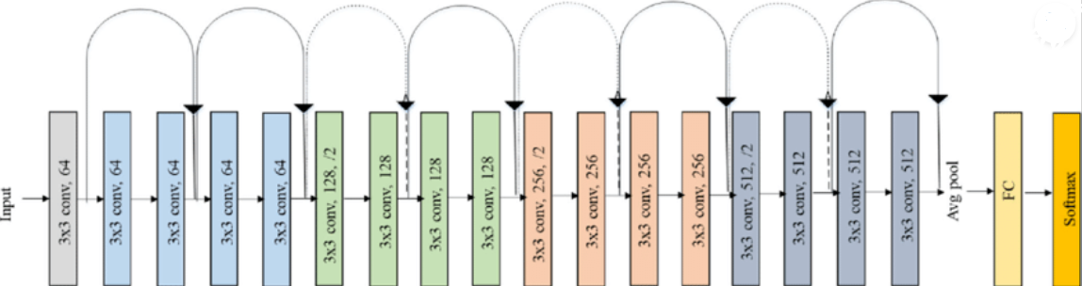
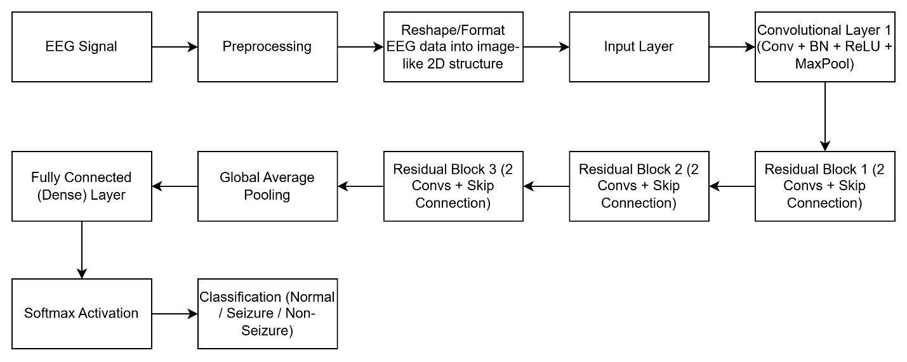
2D CNN(RESNET-18):
Architecture Block diagram

Slide 39
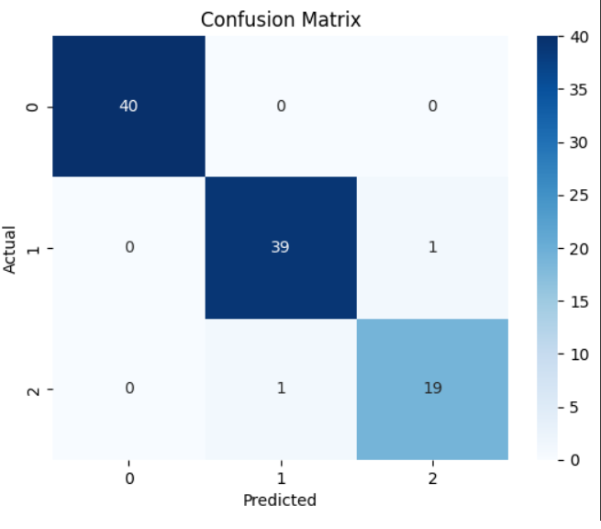
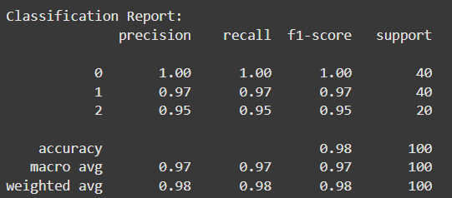
Classification report & confusion matrix:

Slide 40
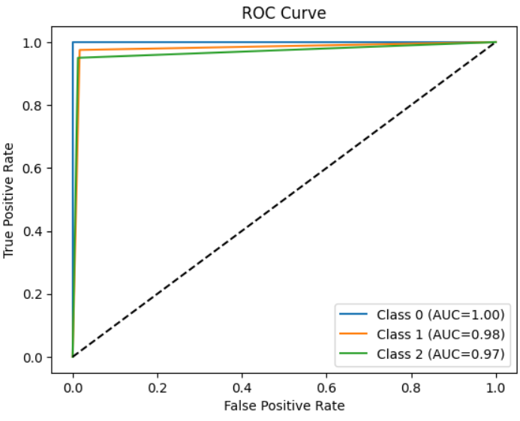
TESTED RESULTS FOR 2D CNN(RESNET-18):
Predicted labels for x_val:
[0, 0, 0, 0, 0, 0, 0, 0, 0, 0, 0, 0, 0, 0, 0, 0, 0, 0, 0, 0, 0, 0, 0, 0, 0, 0, 0, 0, 0, 0, 0, 0, 0, 0, 0, 0, 0, 0, 0, 0, 1, 1, 1, 1, 1, 1, 1, 1, 1, 1, 1, 1, 1, 1, 1, 1, 1, 1, 1, 1, 1, 1, 1, 1, 1, 1, 1, 1, 1, 1, 1, 1, 1, 1, 1, 1, 1, 1, 1, 1, 2, 2, 2, 2, 2, 2, 2, 2, 2, 2, 2, 2, 2, 2, 2, 1, 2, 2, 2, 2]
Actual y_val labels:
[0 0 0 0 0 0 0 0 0 0 0 0 0 0 0 0 0 0 0 0 0 0 0 0 0 0 0 0 0 0 0 0 0 0 0 0 0 0 0 0 1 1 1 1 1 1 1 1 1 1 1 1 1 1 1 1 1 1 1 1 1 1 1 1 1 1 1 1 1 1 1 1 1 1 1 1 1 1 1 1 2 2 2 2 2 2 2 2 2 2 2 2 2 2 2 2 2 2 2 2]

Slide 41
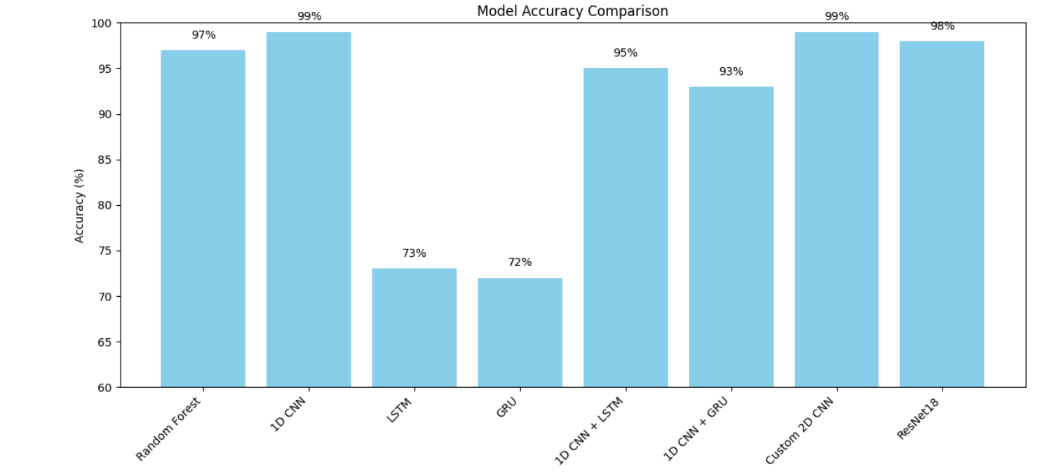

Slide 42
CONCLUSION:
We evaluated multiple models for EEG-based seizure detection. Traditional machine learning with Random Forest achieved 97% accuracy.
Deep learning models like 1D CNN and Custom 2D CNN gave high accuracy of 99%.
While standalone LSTM and GRU models performed lower with 73% and 72% respectively, combining them with 1D CNN improved results.
The best-performing deep learning model overall was ResNet18, achieving 98% accuracy.
This analysis shows that deep learning, especially CNN-based models, significantly improves classification accuracy in EEG signal analysis.
Custom 2D CNN and ResNet18 provided the best balance of accuracy and reliability.
ResNet18 is the most efficient and accurate choice for EEG seizure detection.

Slide 43
REFERENCES :
[1] S. A. Siddiqui, H. Menendez, G. Huang, and F. K. Hussain, "A review on epileptic seizure detection using machine learning classifiers" Expert Systems with Applications, vol. 149, Art. no. 113319, 2020.
[2] A. Guerrero, R. Parada, and C. Espitia, "Epileptic seizure detection using EEG sound analysis and machine learning techniques" in Proc. IEEE Colombian Conf. Applications in Computational Intelligence (ColCACI), Bogotá, Colombia, pp. 1–6, 2021.
[3] A. Gramacki and J. Gramacki, "Detection of neonatal seizures using deep convolutional neural networks" Biomed. Signal Process. Control, vol. 71, Art. no. 103154, 2022.
[4] H. Kode, K. Elleithy, and L. Almazaydeh, "A hybrid machine learning and deep learning approach for epileptic seizure detection" Biomed. Signal Process. Control, vol. 86, Art. no. 104227, 2024.

Slide 44
THANK YOU

